Slide 1
Networking Fundamentals
Foundations of Ethernet and IP

Slide 2
Layer 2 Concepts
#
Switching principles

Slide 3
Layer 2 Addressing
Layer 2 address is called a Media Access Control (MAC) address
MAC addresses must be unique within a broadcast domain
Layer 2 protocol data unit is a frame
MAC addresses are 48 bits long, written as 12 hexadecimal characters
01:23:45:67:89:AB
0123.4567.89AB
Broadcast MAC Address
FF:FF:FF:FF:FF:FF
Multicast MAC Address Range
01:00:5E:00:00:00 – 01:00:5E:7F:FF:FF

Slide 4
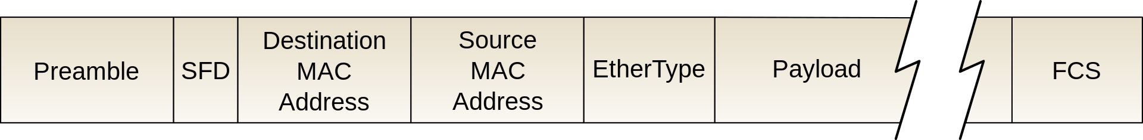
Layer 2 Header
Both source MAC address and destination MAC address are included in layer 2 header
Switches use the source MAC address in the frame to build CAM table

Slide 5
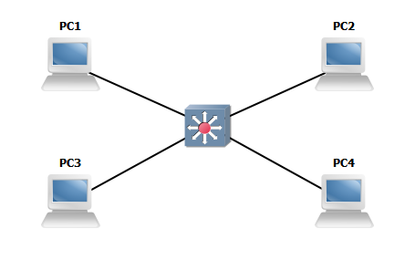
MAC Learning and Aging
A switch’s main purpose is to learn what port each MAC address lives on
Switch looks at the source MAC of incoming frames and saves to the CAM table
Entries in CAM table will age out when idle for a period of time

Slide 6
Frame Forwarding and Flooding
To forward a frame, the switch inspects the destination MAC address
If an entry exists in CAM table for destination MAC, the frame is forwarded
If entry does not exist, or the destination is broadcast, the frame is flooded

